Slide 1
Who Wore it Best?
Market Segments of Wearable Technology
Evan Kramer

Slide 2
Agenda
Why wearables?
The problem at hand (and who benefits)
Data preparations
Modeling approaches
Results and implications
Next steps

Slide 3
Agenda
Why wearables?
The problem at hand (and who benefits)
Data preparations
Modeling approaches
Results and implications
Next steps

Slide 4
What are wearables?
Smartwatches and fitness bands
Excluded VR headsets
Compatibility with other activities
E.g., can’t wear VR headsets on the go

Slide 5
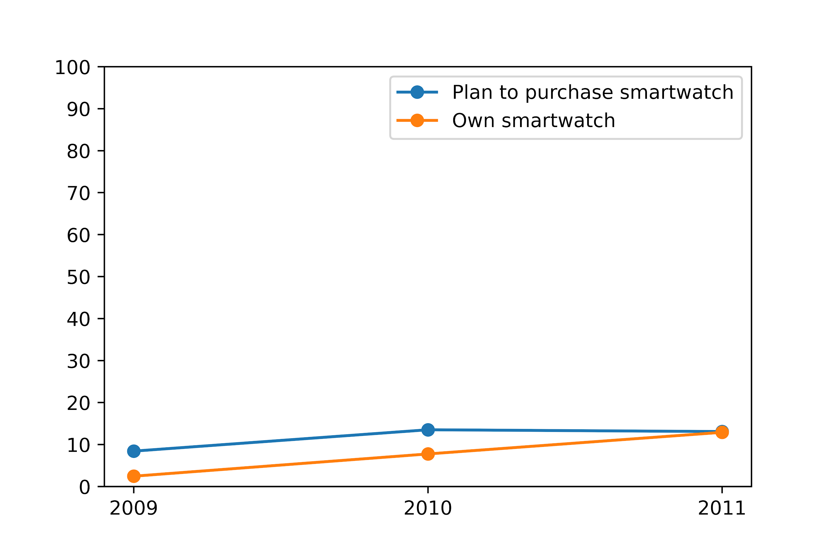
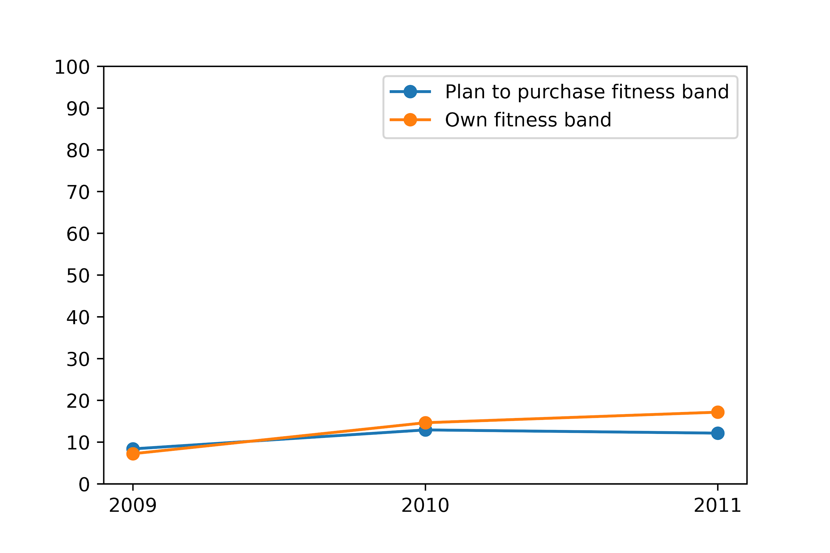
Ownership and interest keep increasing for smartwatches and fitness bands...
Notes:
Wearable technology refers to technology you can wear (routinely)
I will exclude VR headsets because they are more conspicuous (i.e., can’t integrate into the rest of your day/can’t wear them to work unless you do very specialized work)
There is still an untapped market

Slide 6
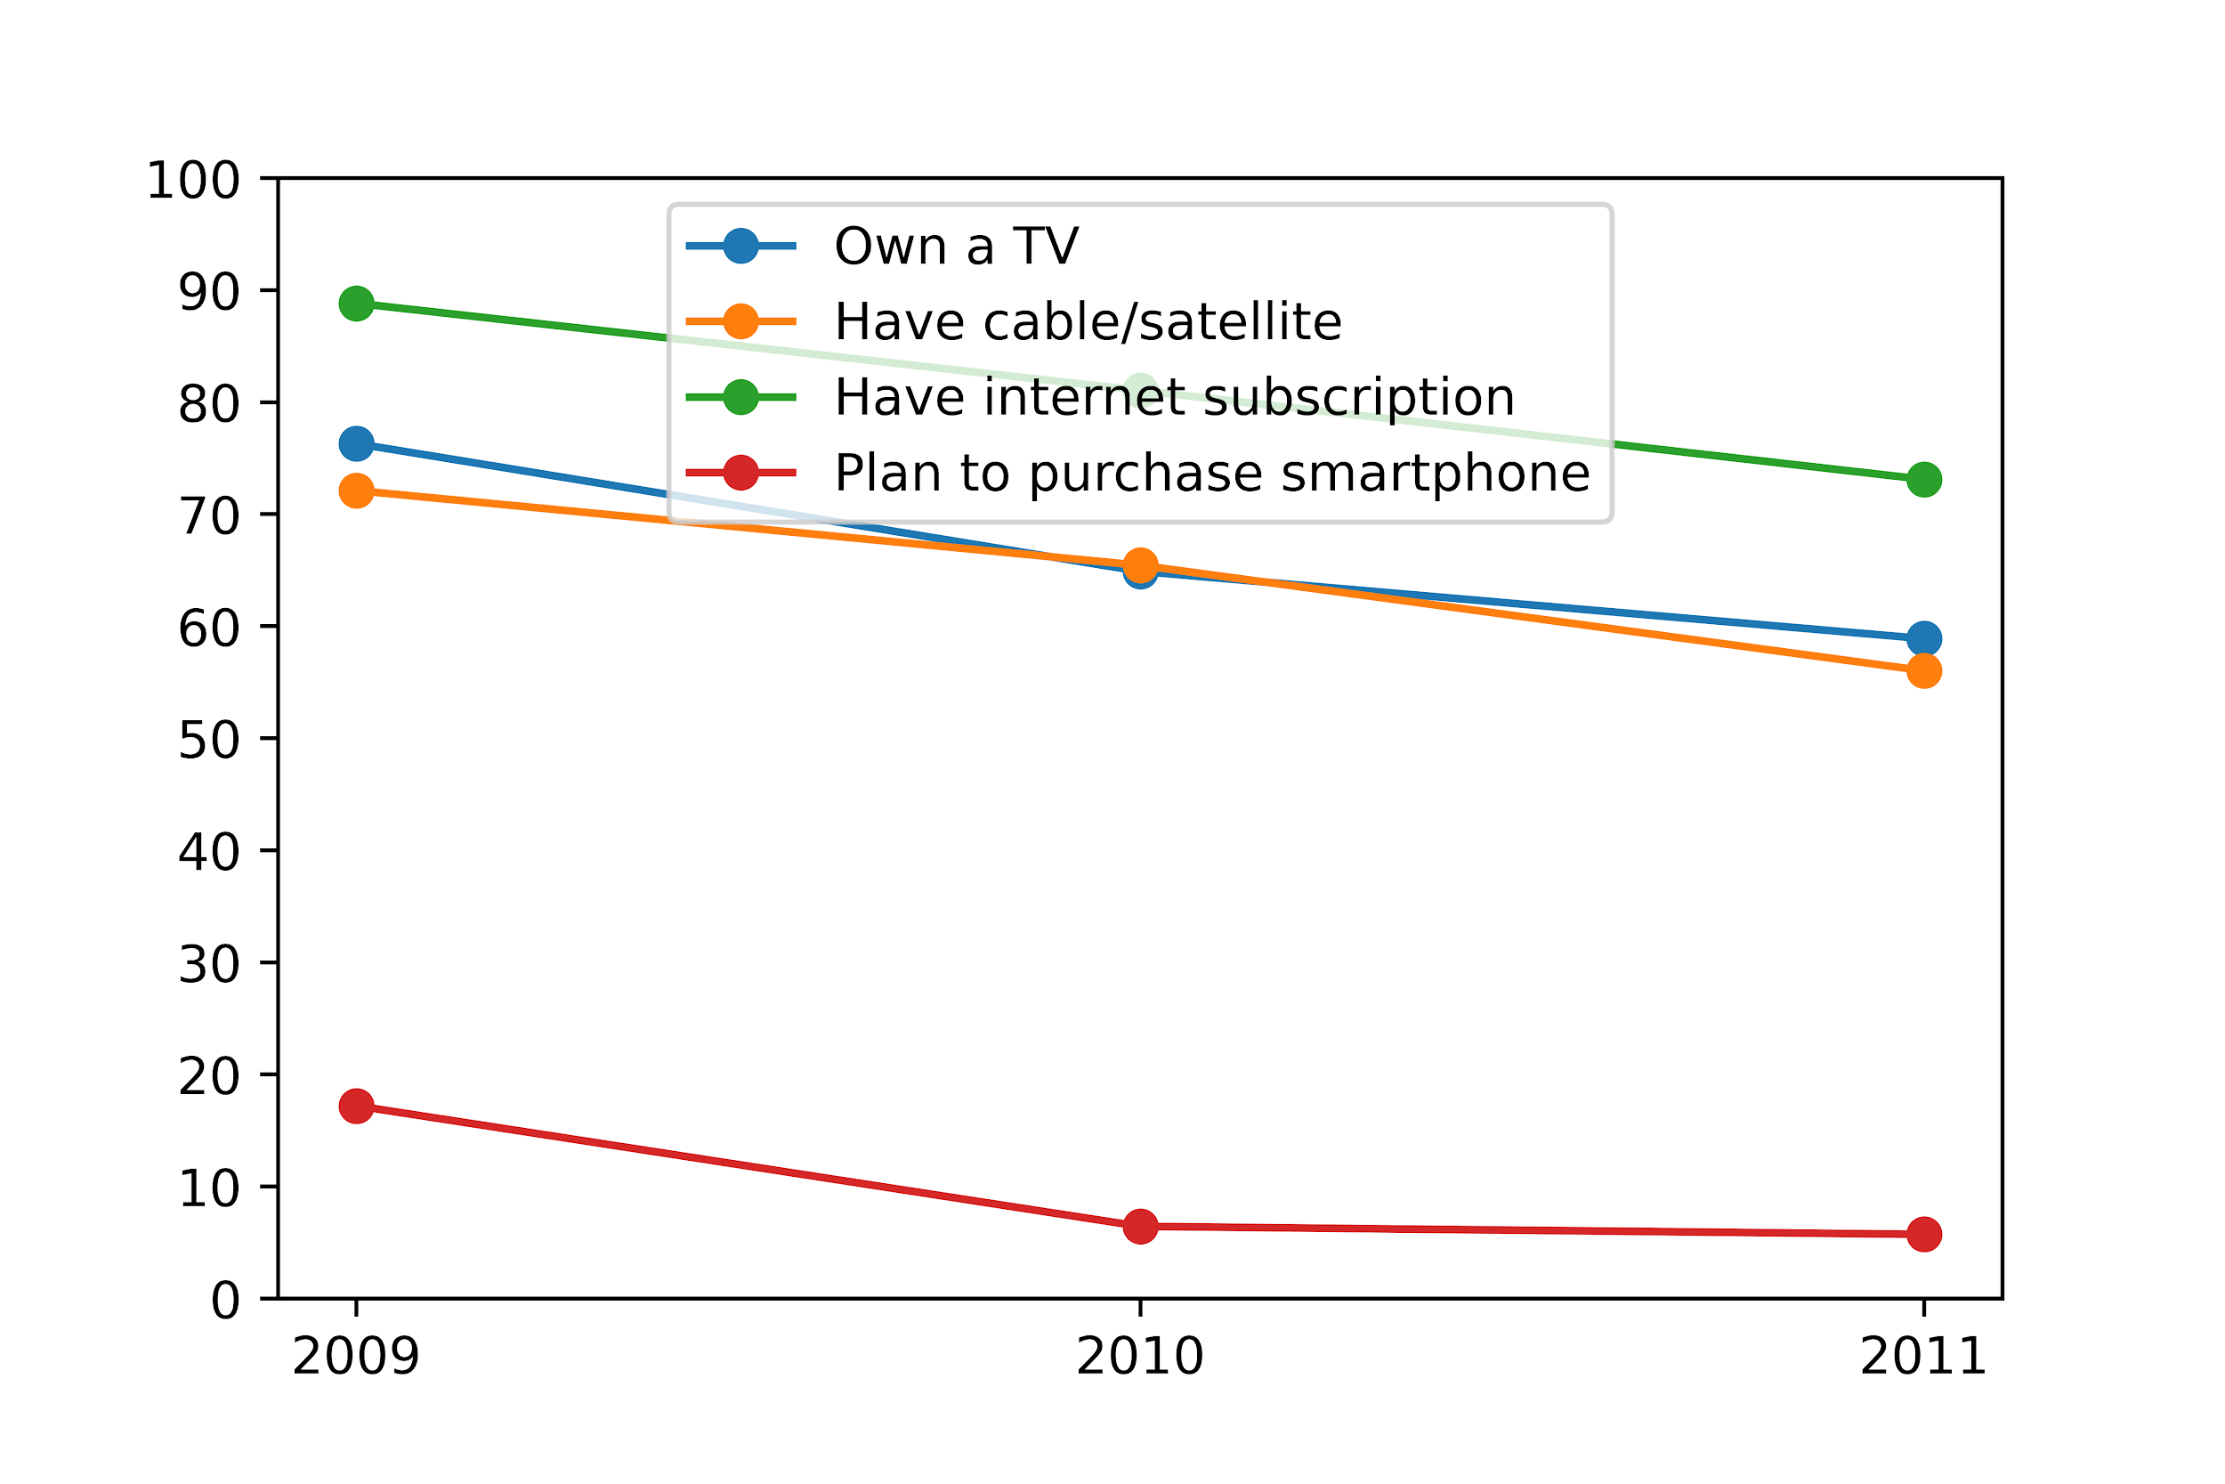
...while consumers are ditching older technologies.
Notes:
Wearable technology refers to technology you can wear (routinely)
I will exclude VR headsets because they are more conspicuous (i.e., can’t integrate into the rest of your day/can’t wear them to work unless you do very specialized work)
There is still an untapped market

Slide 7
Agenda
Why wearables?
The problem at hand (and who benefits)
Data preparations
Modeling approaches
Results and implications
Next steps

Slide 8
We’ll explore market segmentation for wearables.
What are the market segments for wearables?
Who is planning to purchase?
How big is the market?
Which advertising channels are more likely to get customers to buy?
Which apps do they use?
Where do they get news?

Slide 9
Who benefits from this analysis?
Producers of wearables
Targeted advertising
Better exposure, conversion
Advertisers (in certain channels)
Premium ad space (for those interested in purchasing wearables)
One-third of respondents would give personal info for targeted ads
Consumers
Product access
More relevant ads

Slide 10
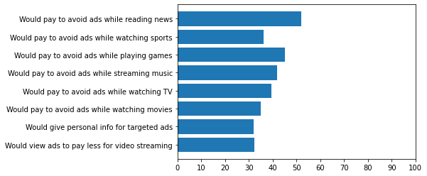
People dislike ads.
Notes:
Capturing their interest matters.

Slide 11
Agenda
Why wearables?
The problem at hand (and who benefits)
Data preparations
Modeling approaches
Results and implications
Next steps

Slide 12
Exploratory data analysis
Outcomes of interest: Plan to purchase smartwatch, fitness band
Predictors of interest:
Demographics
Products owned and planned to purchase
Frequent app usage
Streaming subscriptions (video and music)
News subscriptions
Most frequent news medium

Slide 13
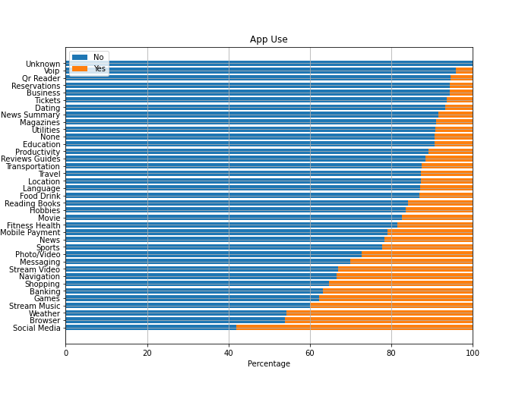
Use varies widely by app type.

Slide 14
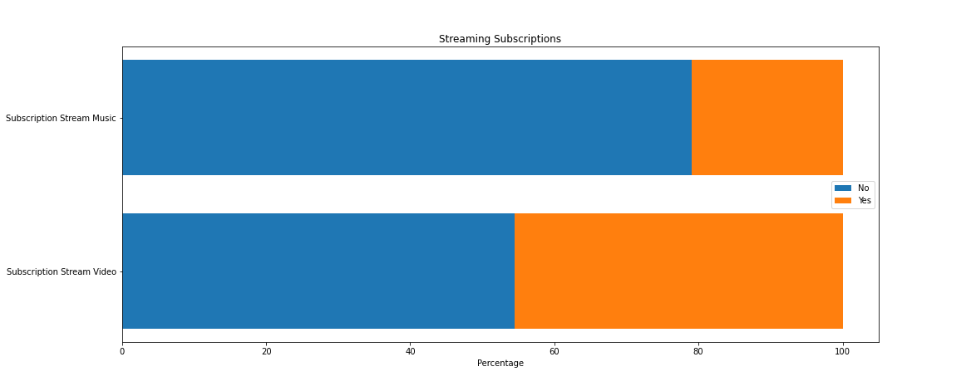
More folks subscribe to video streaming than music.

Slide 15
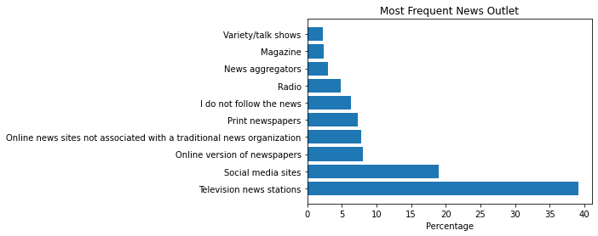
Most people get their news from TV and social media.

Slide 16
Exploratory data analysis
Longitudinal dataset: Standardized/combined names
E.g., large smartphone and small smartphone => smartphone
Greatest year-over-year differences
Restricted to 2011 data (after initial longitudinal analysis)
Converted variables (string, categorical, numeric)
Computed summary statistics
Checked for missing values, unbalanced classes

Slide 17
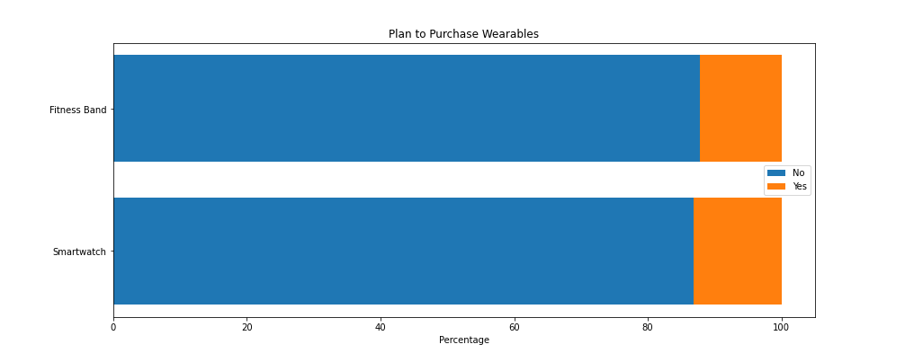
I up-sampled to combat unbalanced classes.
Notes:
So I upsampled the data, which significantly improved model accuracy

Slide 18
Agenda
Why wearables?
The problem at hand (and who benefits)
Data preparations
Modeling approaches
Results and implications
Next steps

Slide 19
The data and use case call for a classification model.
Used random forest classifier
Have both numeric and categorical data
Easily interpreted
Ruled out unsupervised learning models, other classifiers
Logit: Not ideal for categorical variables
SVM: Good classifier, more difficult to interpret

Slide 20
I selected features to find segments and ad channels.
Market segments
Demographics
Targeted app advertising
App use
News consumption
Test feature importances
Used random ‘fold’ variable to check feature importances
Least important feature

Slide 21
Agenda
Why wearables?
The problem at hand (and who benefits)
Data preparations
Modeling approaches
Results and implications
Next steps

Slide 22
How accurate were the models?
Plan To Purchase Smartwatch
Accuracy: 78.9%
Precision: 74.4%
Recall: 89.5%
Plan To Purchase Fitness Band
Accuracy: 78.4%
Precision: 73.1%
Recall: 89.3%
Notes:
precision = tp / (tp + fp)
recall = tp / (tp + fn)

Slide 23
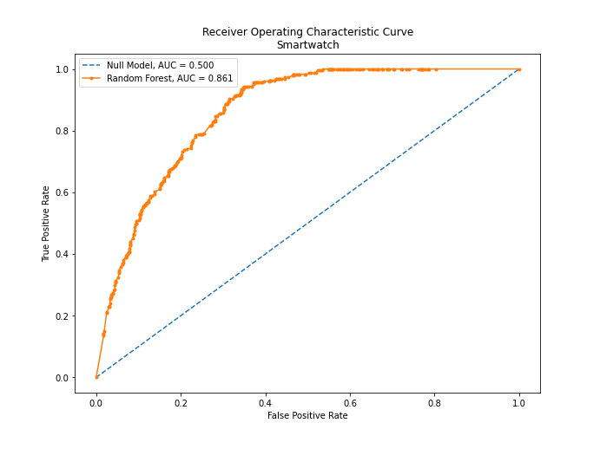
How accurate were the models?

Slide 24
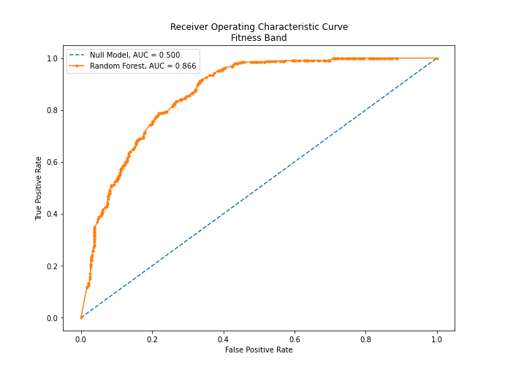
How accurate were the models?

Slide 25
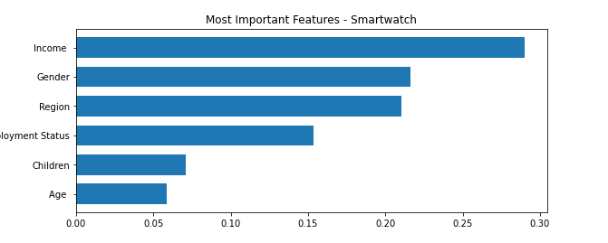
Income and gender were important features for smartwatches...

Slide 26
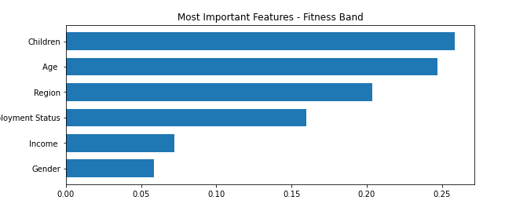
...but much less so than for fitness bands.

Slide 27
What are the market segments?
Who is planning to purchase?
Employed full-time, with disposable income
Males, 34-50 (smartwatches)
Who is not planning to purchase?
Don’t follow news (unless they also don’t have any streaming subscriptions)

Slide 28
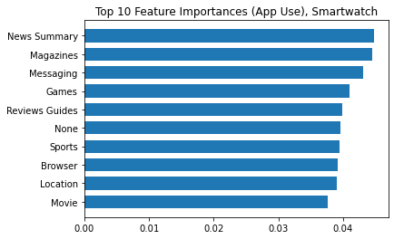
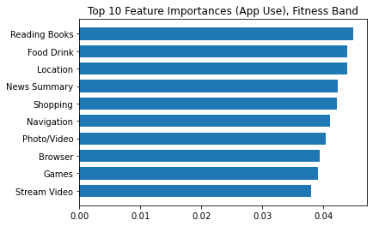
Which features were most important?

Slide 29
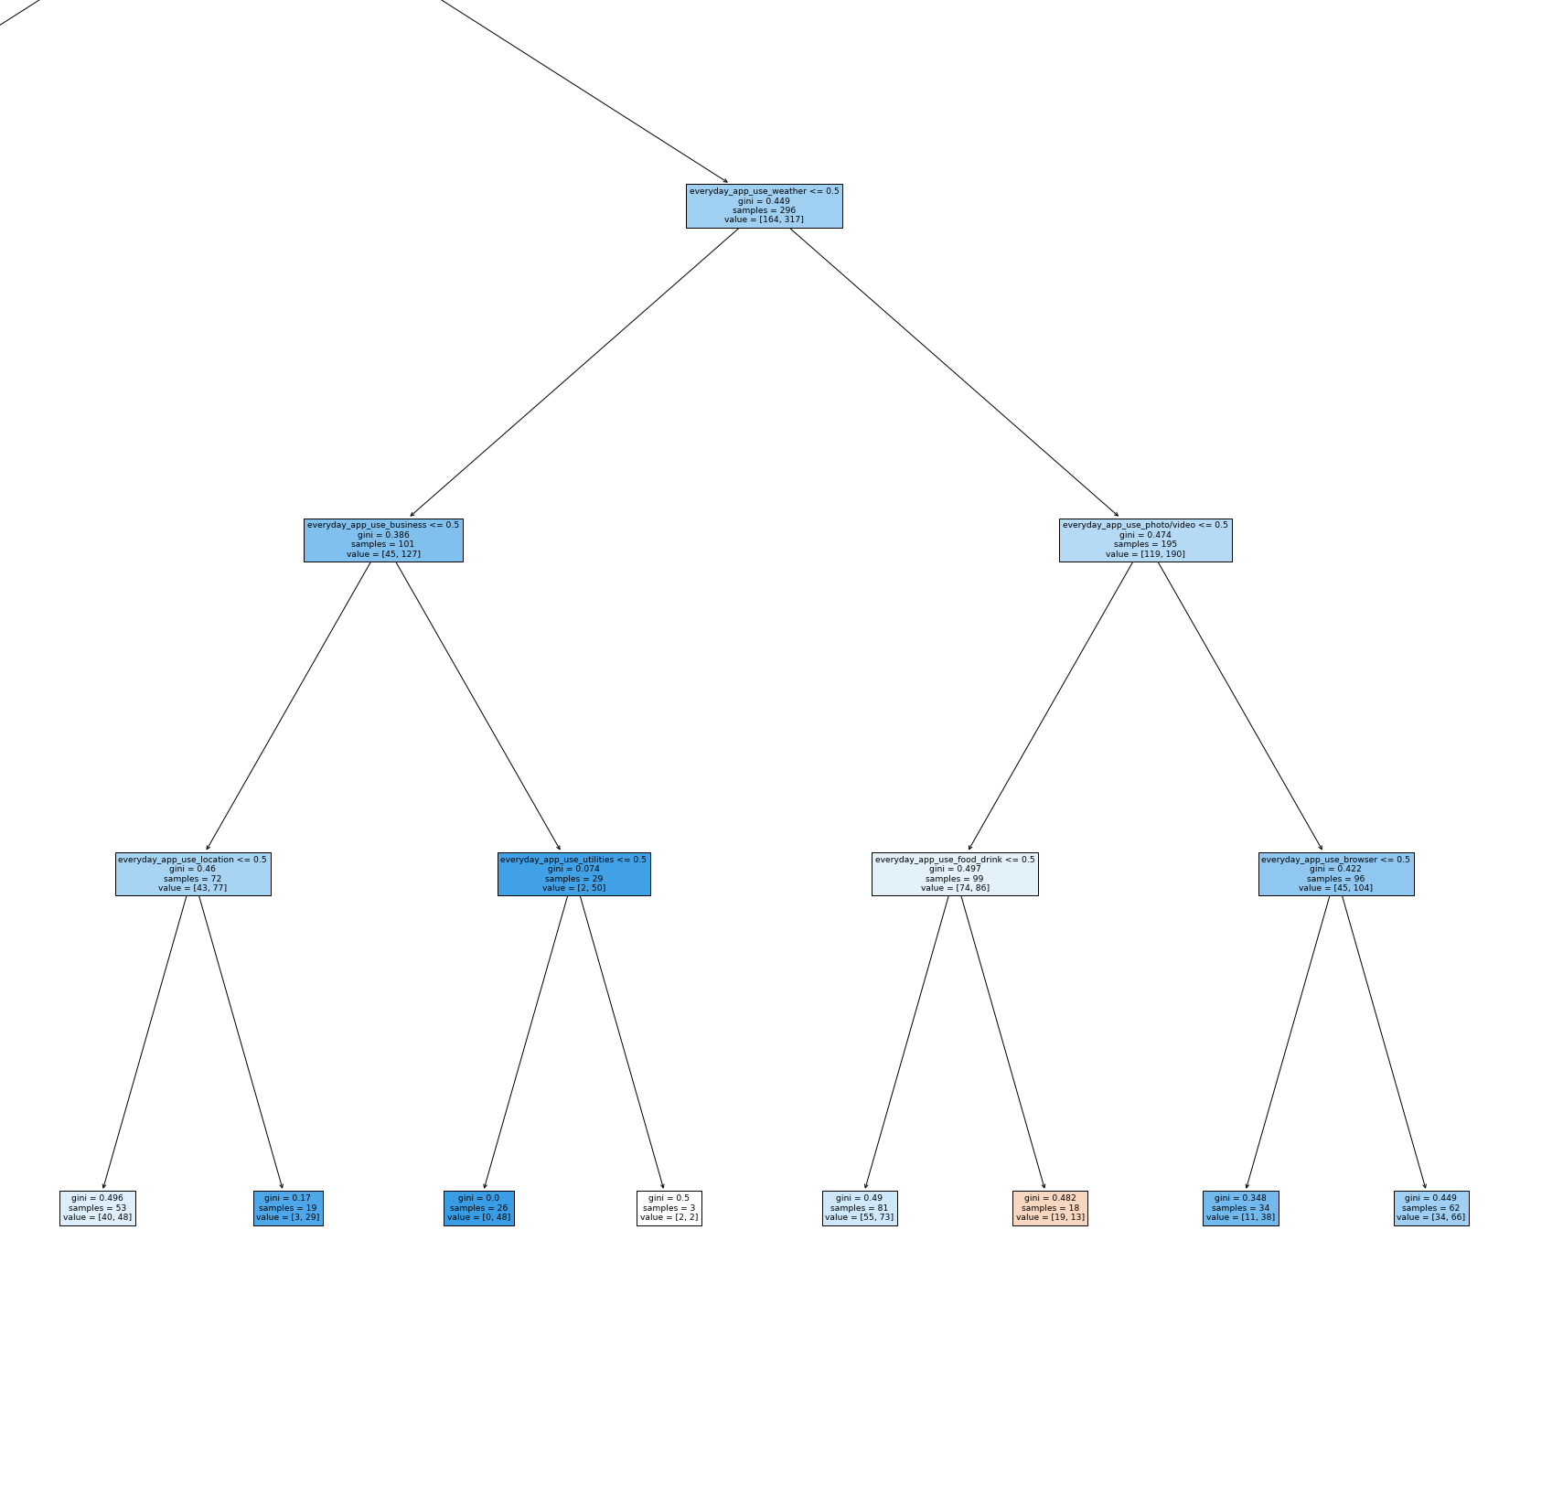
Which ad channels will get customers to buy?
Which apps do they use? Where to advertise?
Utilities
News
Weather
Business
Location
Browser
Where do they get news?
TV, overwhelmingly
Social media

Slide 30
Agenda
Why wearables?
The problem at hand (and who benefits)
Data preparations
Modeling approaches
Results and implications
Next steps

Slide 31
Now what?
Marketing matters
Pay for TV news ad spots
Pay for daily-use, operational apps ads on “freemium” models
E.g., weather, business, news
Gender/income less important for fitness bands
Surprisingly, health/fitness app usage also not frequent
Gather data on actual purchasing behavior
A/B testing opportunities (advertising strategy)

Slide 32
Questions/Feedback?
Evan Kramer
evankram@andrew.cmu.edu

